Slide 1

Bunker Hill Superfund Site
2021 Blood Lead Levels
Panhandle Health District
Idaho Department of Environmental Quality
United States Environmental Protection Agency
May 18, 2022

Slide 2
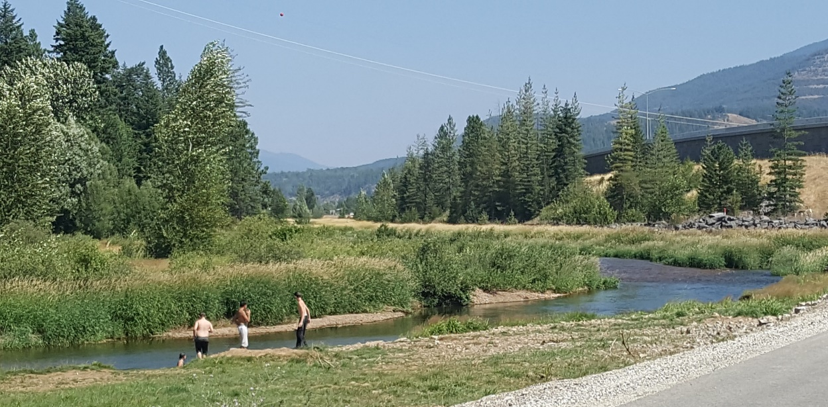
Presentation outline
health effects of lead
lead health intervention Program (LHIP) background
2021 lhip approach
2021 LHIP Results
Notes:
We’ve included some background on Pb effects and the LHIP, which we’ll go over before presenting the 2021 results.

Slide 3
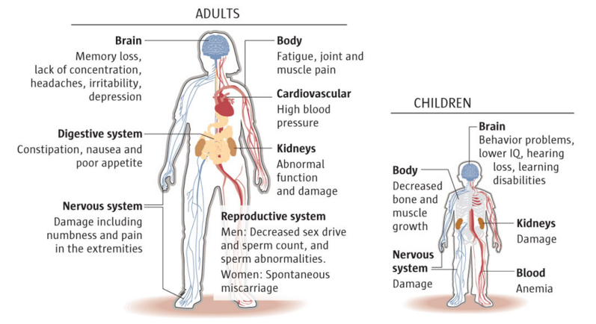
Health Effects of lead
Most common exposure route: incidental ingestion
Notes:
Common Routes of Exposure -
Ingestion – Most common exposure route. Absorption in the body varies – “The fraction of ingested Pb absorbed from the gastrointestinal tract depends on many factors, including age, diet, nutrition, and physiological characteristics of Pb in the medium ingested.” (ATSDR 2020)
Inhalation – Almost all lead deposited in the lungs is absorbed into the body (ATSDR 2020)
“Pb in submicron size particles can be almost completely absorbed through the respiratory tract, whereas larger particles may be moved after deposition in the respiratory tract by mucociliary clearance toward the oropharynx and swallowed.”
“Absorption of deposited Pb is influenced by particle size and solubility as well as the pattern of regional deposition within the respiratory tract.”
Blood serves as the initial receptacle of absorbed lead and distributes throughout the body, making it available to all soft tissue organs.
Reference: Agency for Toxic Substances and Disease Registry (ATSDR). 2020. Toxicological Profile for Lead. Atlanta, GA: U.S. Department of Health and Human Services, Agency for Toxic Substances and Disease Registry. https://wwwn.cdc.gov/TSP/ToxProfiles/ToxProfiles.aspx?id=96&tid=22

Slide 4
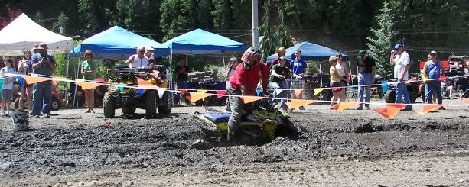


At Risk Populations
Blood lead test is the best tool for identifying exposure & health risks
Notes:
Children – more affected by lead due to behavior & physiology
No safe blood lead threshold for the adverse effects of lead on infant or child neurodevelopment
Pregnant women – readily crosses the placenta adversely affecting the fetus
Adults with cumulative exposure – typically, recreational, occupational, or hobby related
Latent effects of lead exposure during childhood for adults
Genetically pre-disposed individuals
Lead exposure often occurs with no obvious symptoms – a blood lead test is the best tool for identifying exposure & health risks

Slide 5
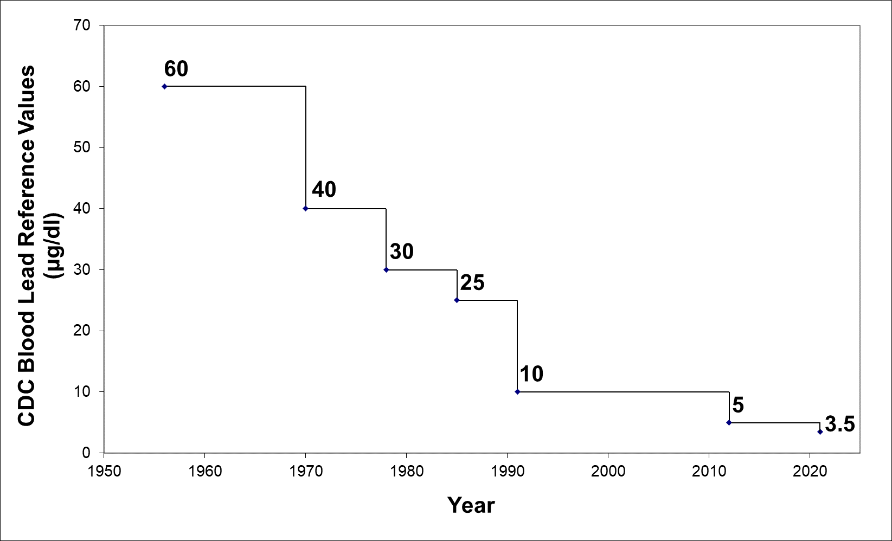
Decreasing “elevated” blood lead levels
Blood Lead Concentrations Considered to be Elevated by the Centers for Disease Control and Prevention.
Notes:
CDC recommendation is now 3.5 ug/dL. Was 25 ug/dL when OU1 ROD was being developed.

Slide 6
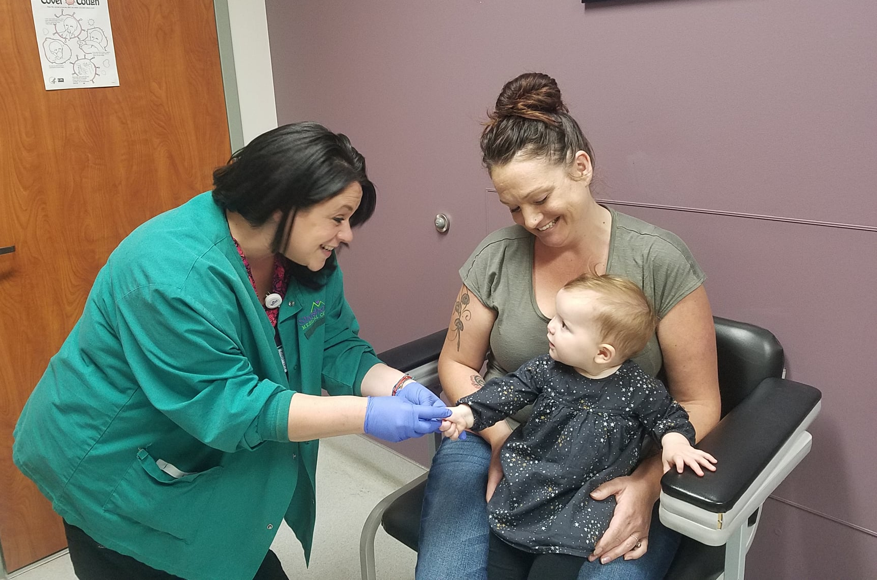
Lead Health Intervention Program (LHIP)
Public health service
Not a study or experiment
Box since 1974/1985
Basin since 1996
Notes:
Annual blood lead surveys are a public health service offered by the State through PHD-Kellogg
Not a study or experiment

Slide 7
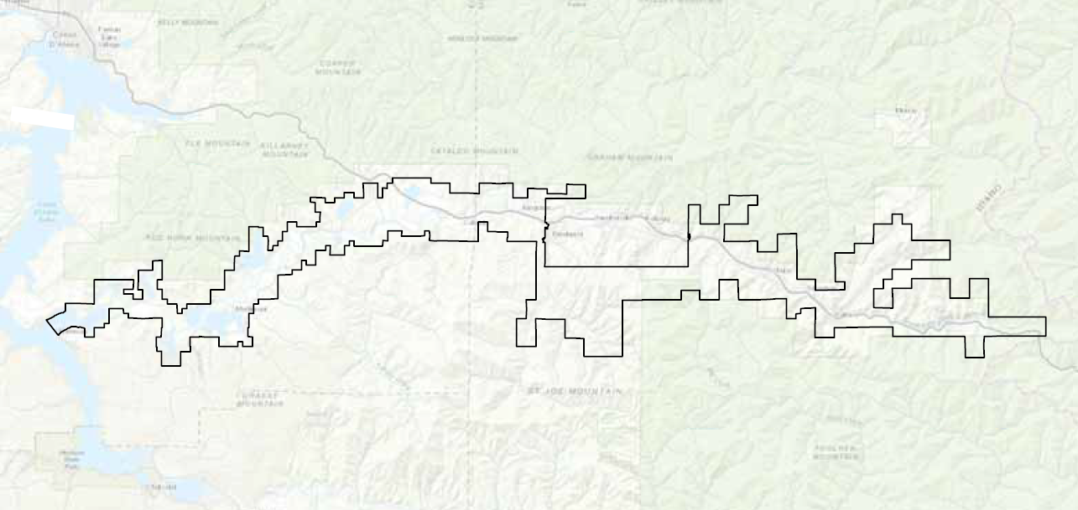
LHIP participant criteria & incentive
Live and/or recreate within the Bunker Hill Superfund Site
$40.00 cash incentive for participants 6 months - 6 years of age
Notes:
Live and/or recreate within the Bunker Hill Superfund Site
$40.00 cash incentive for participants between 6 months and 6 years of age

Slide 8
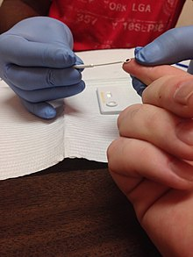
Panhandle Health District
LHIP Procedures
Informed consent
Screening blood test by capillary (i.e., fingerstick [FS])
All FS ≥5 µg/dL are followed-up with a venous confirmation test
Offer consultations and follow-up with all children ≥5 µg/dL
Notes:
Informed consent: the parent/legal guardian or adult participant must sign a Consent Form and complete the appropriate Questionnaire
Screening blood test by skin puncture (capillary or fingerstick [FS])
FS results are provided to the participant or parent immediately after analysis
All FS results ≥5 µg/dL are followed-up with a venous confirmation test
Offer consultations and follow-up with all children ≥5 µg/dL

Slide 9
Presentation outline
health effects of lead
lead health intervention Program (LHIP) background
2021 lhip approach
2021 LHIP Results
Notes:
Special considerations and different approaches in 2021…

Slide 10
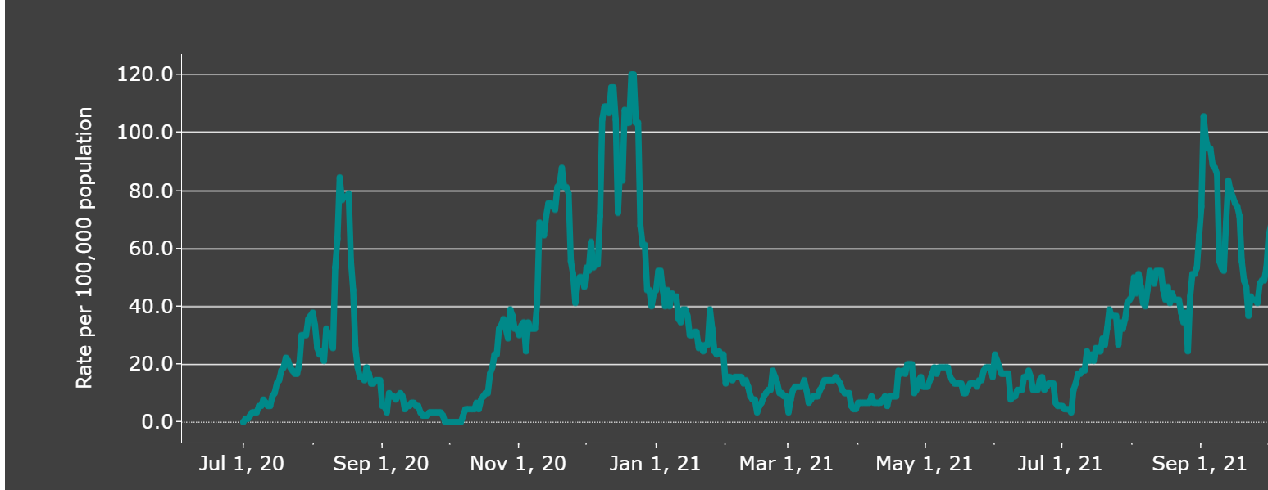
2021 LHIP Approach
Positive covid cases in Shoshone County
Source: https://public.tableau.com/app/profile/idaho.division.of.public.health/viz/DPHIdahoCOVID-19Dashboard/Home, accessed on December 10, 2021
Notes:
New procedures: Scheduling appointments and mask requirements
PHD held 2021 BLPB screening August 9th – 14th when COVID was on the rise again.
To follow with CDC’s Covid-19 guidelines, PHD held the event by appointment only & required attendants 4 years and older to wear masks.
We noticed a decline in the number of participants using the 2021 approach, versus previous walk-in screenings, but still successful with a total of 101 participating children age 6 months- 6 years living or recreating in the ICP boundary.

Slide 11
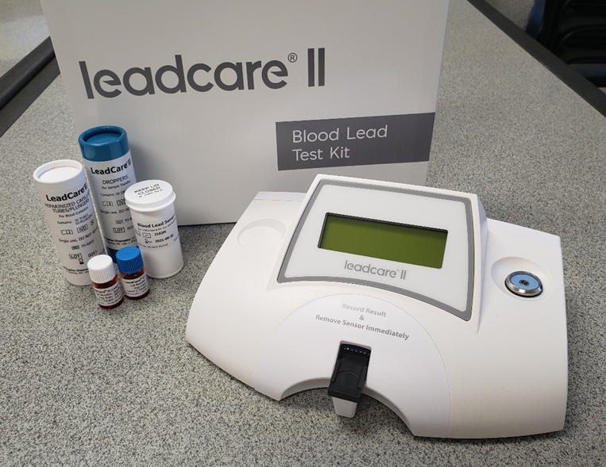
2021 LHIP Blood Lead procedures
Prior years: LeadCarePlus Analyzer used for capillary test (detection limit = 1.9 ug/dL)
Before LHIP screening, the hospital received recall notice for LeadCarePlus test kits
Secured substitute analyzer (LeadCarell) and new test kits (detection limit = 3.3 ug/dL)
Began testing 8/9/2021
Notes:
New Test Kits - and at the last minute

Slide 12
Capillary quality control (QC) results
Date | Within QCª Target Range? | Notes
8-9-2021 through 8-11-2021 | Yes
8-12-2021 | No | Ran 7 controls – all low. Called hotline. Venous draws only
8-13-2021 | No | Venous draws only
ª QC Target Ranges: Level 1 = 7.2 ug/dL (± 3.0)
Level 2 = 23.6 ug/dL (± 4.3)
Notes:
Followed all procedures including Quality Control checks. The first 3 days capillary QC was alright, by day 4, QC was out of range and PHD followed all procedures and called the hotline. Switched to all venous.
Kit Lot No.: 2102m-04; QC Lot No.: 2102m

Slide 13
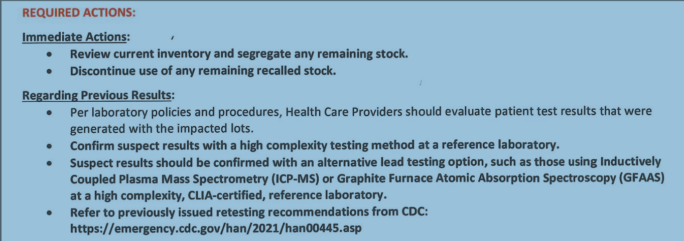
RECALL after LHIP screening – 8/31/21
Notes:
In addition to the recall prior to the screening event, another recall occurred after the event.

Slide 14
Change in 2021 result summaries
Capillary not combined with venous results - due to high detection limit and potential low results from recall issues
Area | No. of Participants | No. (%) Nondetects | Detection Limit (µg/dL)
Basin | 44
Capillary | 25 | 24 (96%) | 3.3
Venous* | 19 | 6 (32%) | 1
Box | 57
Capillary | 19 | 18 (95%) | 3.3
Venous* | 38 | 13 (34%) | 1
*Four participants had capillary results that were confirmed with a venous sample. Only the venous result is counted.
Notes:
Venous results validated & reportable. This presents the eligible children participating in the screening event.

Slide 15
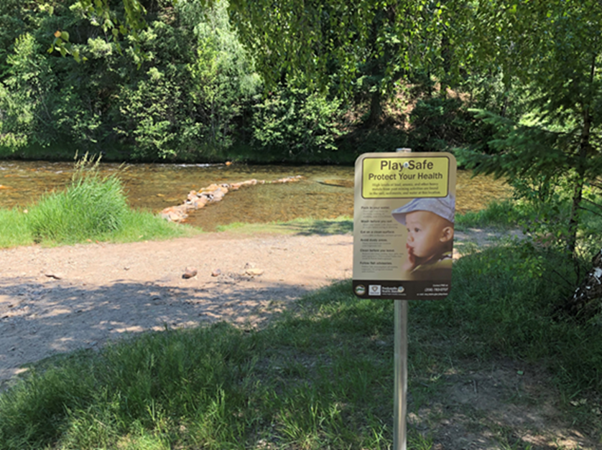
2021 results in “the Box”
Operable units (OU) 1 & 2

Slide 16
Box Remedial Action Objectives
No more than 5% of children in each community have blood lead levels >10 µg/dL
Less than 1% with blood lead levels >15 µg/dL
Notes:
First – let’s put context around the 2021 results. These are goals established in 1991 ROD using the 10 ug/dL reference dose. The next 2 slides show how far we’ve come in reducing children’s BLPB levels living in the Box…

Slide 17
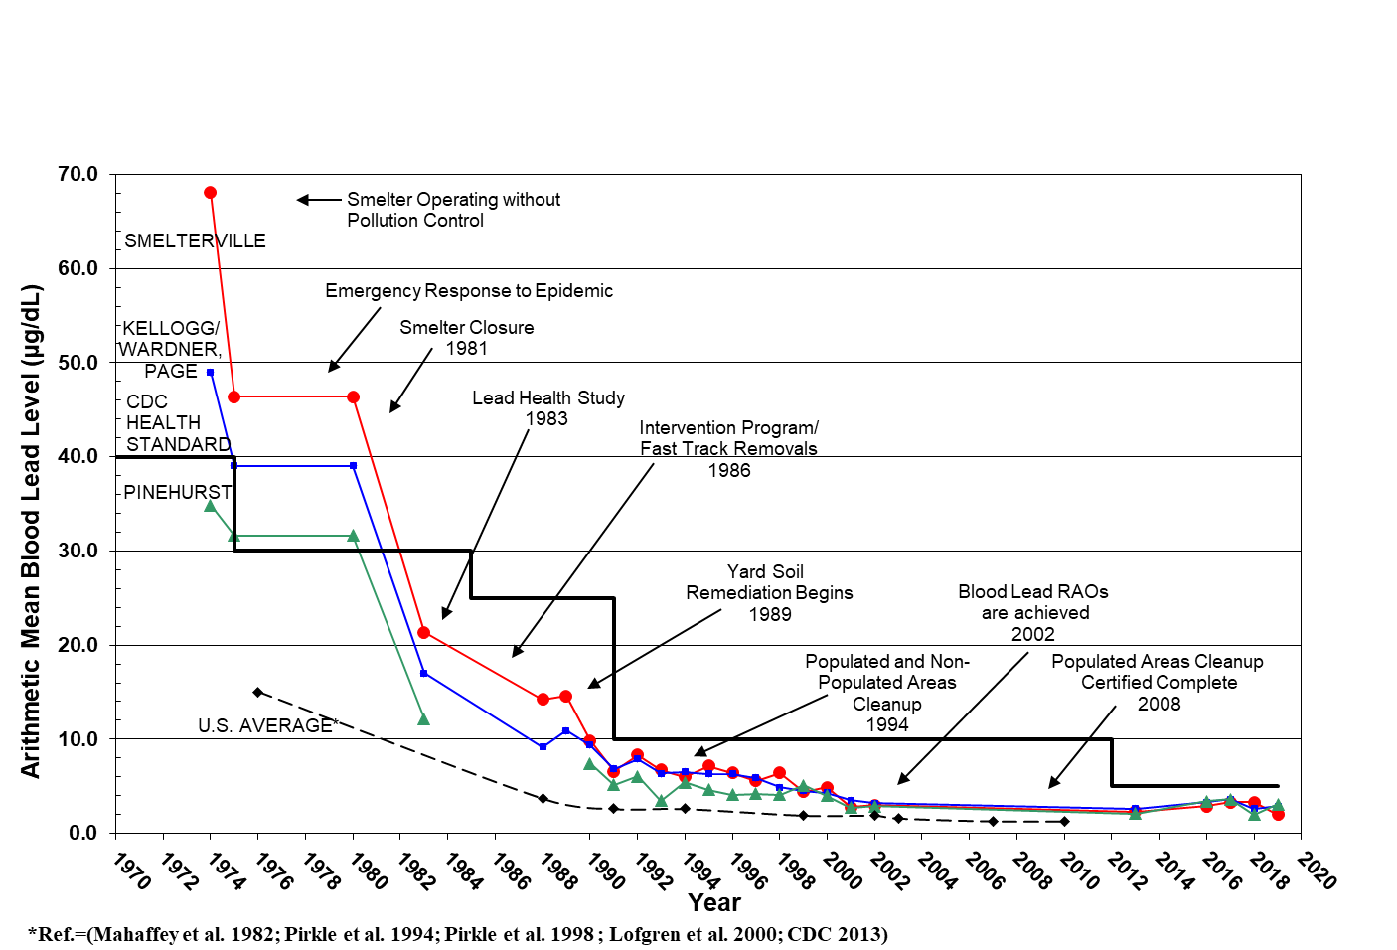
Bunker Hill Box Average Blood Lead: 1974-2019*
*not enough samples in 2020 & 2021

Slide 18
Percent of Box Children with Blood Lead Levels ≥10 ug/dL, by City, 1988-2019*
*not enough samples in 2003-2012, 2014, 2015, 2020, & 2021
Since 1998, ≤10 participants/year in Page & Wardner

Slide 19
2021 Blood Lead Summary Statistics:
Box (age 6 months-6 years)
Total Number of Children (N) 38
Minimum (μg/dL) <1
Maximum (μg/dL) 10
Average (μg/dL) 1.5
Standard Deviation 1.6
Geometric Mean (μg/dL) 1.2
Geometric Standard Deviation 1.7
Number / Percent Below Detection 13 (34%)
Number Percentage
Children’s blood lead > 3.5 μg/dL 2 5%
Children’s blood lead > 5 μg/dL 2 5%
Children’s blood lead > 10 μg/dL 1 3%
Children’s blood lead > 15 μg/dL 0 0%
Note: Venous blood sample results only. An additional 19 children had capillary test results, 18 of which were below detection (<3.3 ug/dL).
Notes:
These are venous results only.
A total of 19 children (6 months to 6 years) had only capillary results in the Box – all but 1 were below detection.
Capillary results are not combined with the venous results and therefore, not presented here due to the high FS detection limit in 2021 and potential underestimation of results from issues with the capillary test kits.

Slide 20
2021 Blood Lead Summary Statistics:
Box (other non-eligible participants*)
Total Number of Participants (N) 13
Minimum (μg/dL) <1
Maximum (μg/dL) 1.0
Average (μg/dL) 1.0
Standard Deviation 0.0
Geometric Mean (μg/dL) 1.0
Geometric Standard Deviation 1.0
Number / Percent Below Detection 9 (69%)
Number Percentage
Blood lead > 3.5 μg/dL 0 0%
Blood lead > 5 μg/dL 0 0%
Blood lead > 10 μg/dL 0 0%
Blood lead > 15 μg/dL 0 0%
*7-73 years; PHD did not have any record of pre-natal screenings during 2021 event. Venous blood sample results only. An additional 8 participants had capillary test results, all of which were below detection (<3.3 ug/dL).
Notes:
Note: Only venous blood sample results are shown. Capillary results were not show due to high detection limit and potential underestimation of results due to issues with the capillary test kits.
A total of 8 non-eligible participants had only capillary results in the Box.

Slide 21
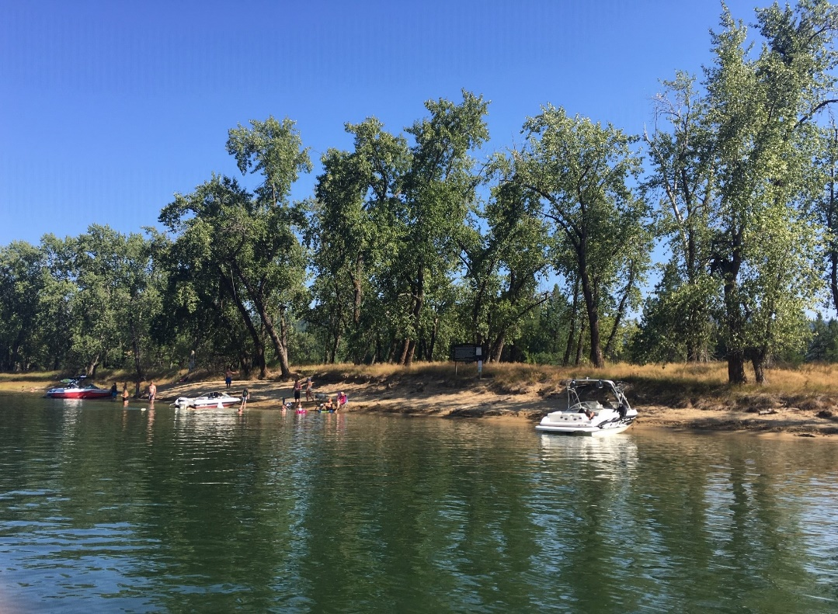
2021 results in the Basin
Operable unit (OU) 3

Slide 22
Basin Remedial Action Objectives
Reduce exposures to soils with concentrations greater than:
  Lead: ≥ 700 mg/kg
  Arsenic: ≥ 100 mg/kg
Reduce exposures to lead in house dust
Cumulative exposures do not exceed USEPA’s health risk goals:
  <5% chance that a typical child at an individual residence does not exceed 10 µg/dL
Notes:
Basin/OU3 RAOs are somewhat different from the Box because the OU3 ROD was signed 11 years later and coincides with the EPA guidance at that time.
In general, the RAOs are to reduce exposures to soils & dusts so there is a low chance of a high BLPB level.

Slide 23
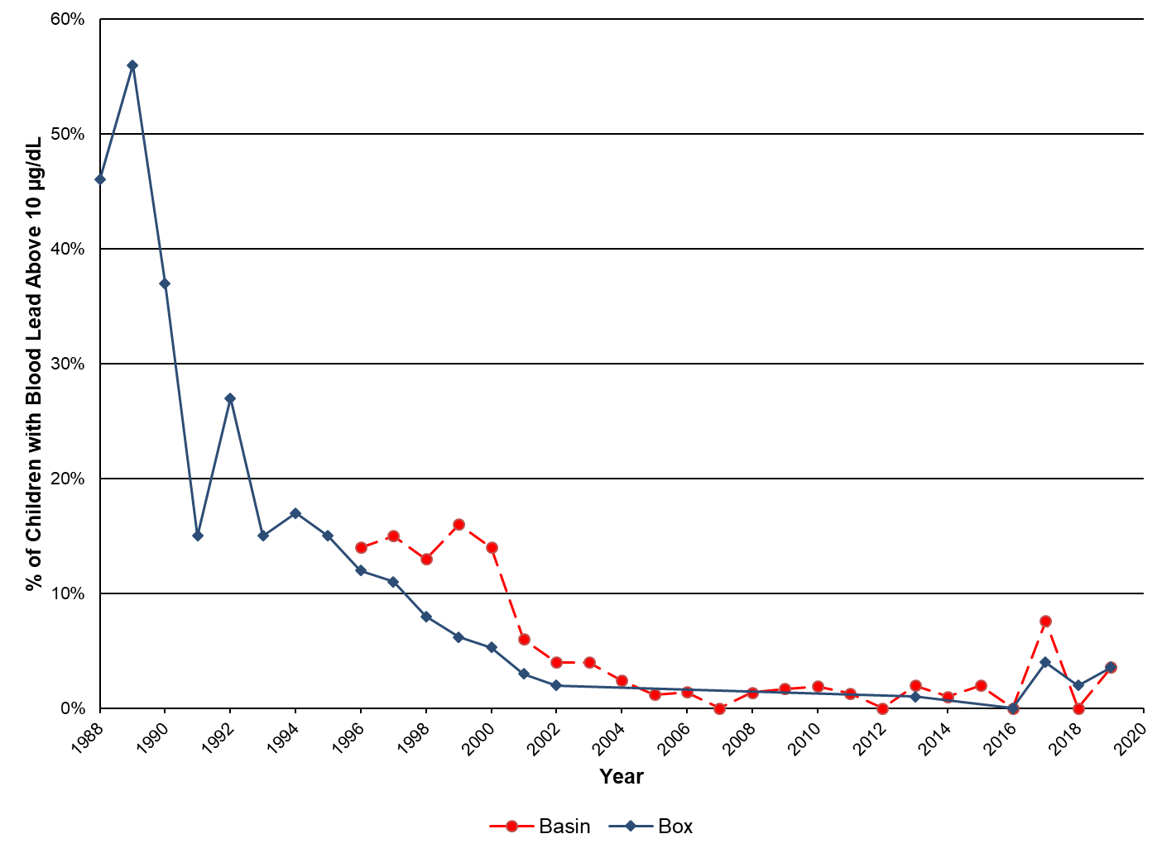
Percent of Children with Blood Lead Levels ≥10 ug/dL, Box and Basin, 1988-2019*
*not enough samples in 2020 & 2021
Notes:
What we’ve seen with BLPB levels in the Basin, relative to the Box

Slide 24
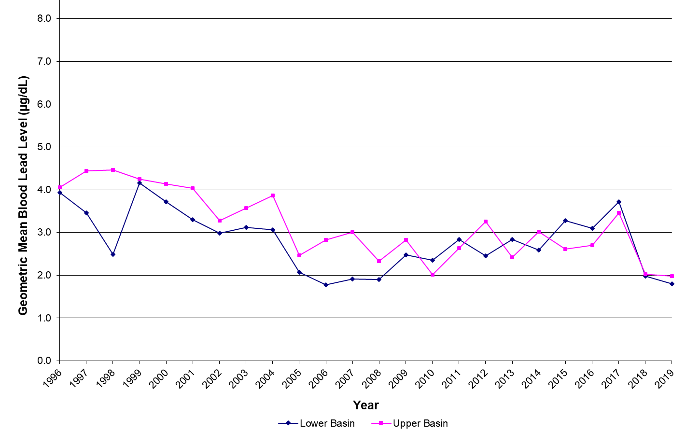
Basin Blood Lead Levels by Year, 1996-2019*
*not enough samples in 2020 & 2021

Slide 25
2021 Blood Lead Summary Statistics:
Basin (age 6 months-6 years)
Total Number of Children (N) 19
Minimum (μg/dL) <1
Maximum (μg/dL) 7
Average (μg/dL) 1.9
Standard Deviation 1.9
Geometric Mean (μg/dL) 1.5
Geometric Standard Deviation 2.0
Number / Percent Below Detection 6 (32%)
Number Percentage
Children’s blood lead > 3.5 μg/dL 3 16%
Children’s blood lead > 5 μg/dL 3 16%
Children’s blood lead > 10 μg/dL 0 0%
Children’s blood lead > 15 μg/dL 0 0%
Note: Venous blood sample results only. An additional 25 children had capillary test results, 24 of which were below detection (<3.3 ug/dL).
Notes:
Note: Only venous blood sample results are shown. Capillary results were not show due to high detection limit and potential underestimation of results due to issues with the capillary test kits. A total of 25 kids 6 months to 6 years old had only capillary results in the Basin.

Slide 26
2021 Blood Lead Summary Statistics:
Basin (other non-eligible participants*)
Total Number of Participants (N) 8
Minimum (μg/dL) <1
Maximum (μg/dL) 12
Average (μg/dL) 2.4
Standard Deviation 3.9
Geometric Mean (μg/dL) 1.4
Geometric Standard Deviation 2.4
Number / Percent Below Detection 5 (50%)
Number Percentage
Blood lead > 3.5 μg/dL 1 13%
Blood lead > 5 μg/dL 1 13%
Blood lead > 10 μg/dL 1 13%
Blood lead > 15 μg/dL 0 0%
*7-64 years or outside ICP boundary; PHD did not have any record of pre-natal screenings during 2021 event. Venous blood sample results only. An additional 13 participants had capillary test results, all of which were below detection (<3.3 ug/dL).
Notes:
Note: Only venous blood sample results are shown. Capillary results were not show due to high detection limit and potential underestimation of results due to issues with the capillary test kits. A total of 13 non-eligible participants had only capillary results in the Basin.

Slide 27
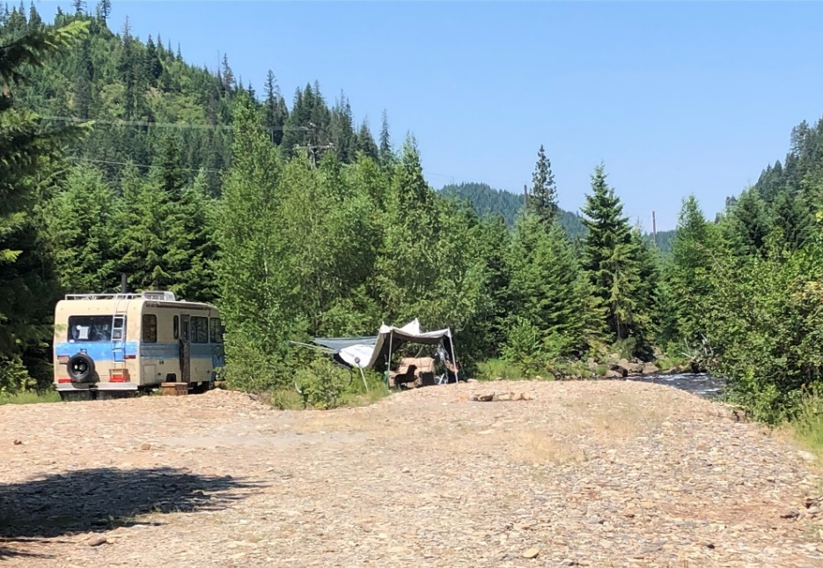
2021 Follow-ups Conducted (Box & basin)
In-home follow ups: 2
Phone consultations: 3
Unable to contact: 1
Identified sources:
  Disturbed barriers
    Work with ICP to re-establish
  Recreating in un-remediated areas
    Additional outreach & follow safety tips to reduce exposure
  Occupational related
    PHD will attempt to work with industries to provide education
  Lead based paint
    Conduct assessment & address if needed
Notes:
PHD offered free in-home consultations to all families or individuals with an elevated lead level >5 ug/dL and recommended that parents or individuals follow up with their physician.
After the screening evet was over in August, the CDC lowered the blood lead reference value from 5.0 µg/dL to 3.5 µg/dL on October 28, 2021. This did not affect the 2021 screening. However, you’ll notice that the data summaries show the % of BLPB results >3.5 μg/dL - and PHD will use this new reference value for follow-ups in future years.

Slide 28

Questions?

Slide 29
Estimated 2021 LHIP Participation Rates
 | Basin | Box
Estimated Child Populationª | 493 | 330
Total No. of Children Participating in LHIP 2021^{b} | 44 | 57
Estimated % of Population Providing Blood Samples | 9% | 17%
ª Eligible population are 6 months - 6 years old children living in the Box and Basin, based on estimates from 2018. ^{b} Count includes children who provided either a capillary or venous blood sample.
Notes:
Extra slide
Typically not in presentation but as a handout

Slide 30
2021 LHIP Participants & Property Remediation Status
Property Remediation Status | Number of Children
 | Basin | Box
No remedial action required or Remediated | 43 | 56
Requires Remediation or Sampling | 1 | 1
Total | 44 | 57
Notes:
Extra slide
Typically not in presentation but as a handout

